Slide 1
The Impulse-Momentum Theorem
Dr. Jacob Moore
Associate Professor of Engineering
Penn State Mont Alto

Slide 2
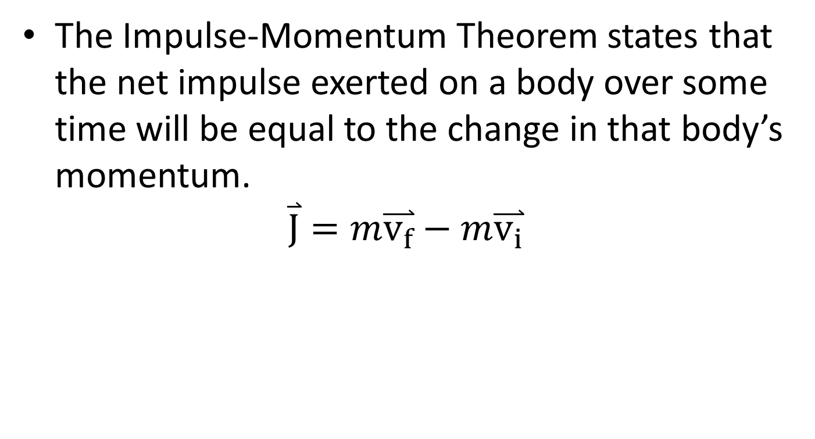
Impulse and Momentum
The Impulse-Momentum Theorem states that the net impulse exerted on a body over some time will be equal to the change in that body’s momentum.
$$\overset{⃑}{J}=m\overset{⃑}{v_{f}}−m\overset{⃑}{v_{i}}$$
Initial Momentum
Impulse
Final Momentum

Slide 3



Solving Impulse Momentum Problems
To use the Impulse Momentum equation to solve problems, it is best to start by creating a diagram showing the initial and final states of the body in question.
If possible, show:
Initial and final velocities
The mass or masses of the bodies
Forces (including magnitude and direction)
Times that forces are exerted
m = 3kg
m = 3kg
40º
$$v_{i}=3m/s$$
$$v_{f}=?$$
$$F_{impact}$$

Slide 4
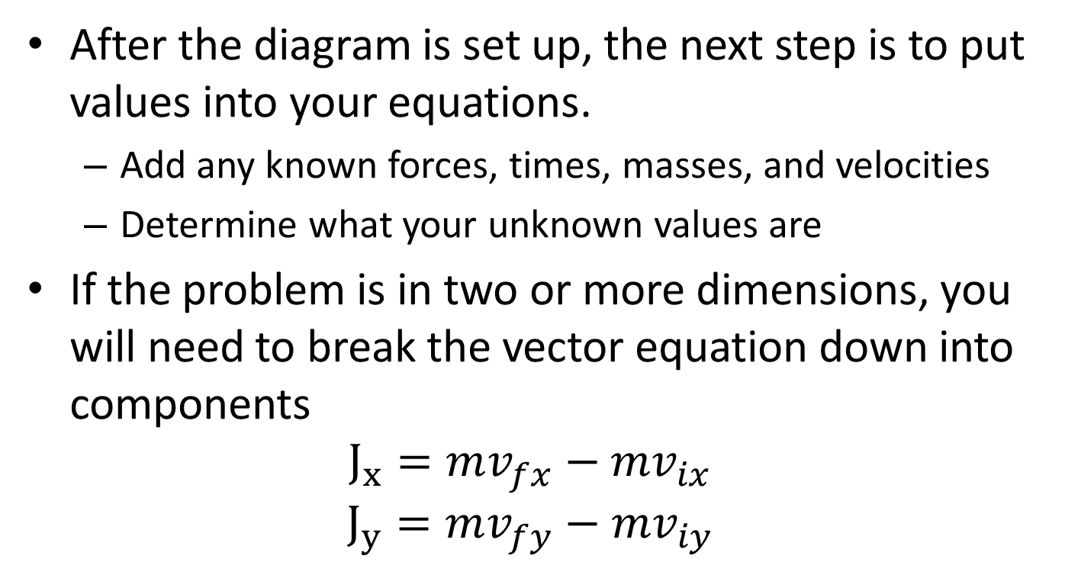
Solving Impulse Momentum Problems
After the diagram is set up, the next step is to put values into your equations.
Add any known forces, times, masses, and velocities
Determine what your unknown values are
If the problem is in two or more dimensions, you will need to break the vector equation down into components
$$J_{x}=mv_{fx}−mv_{ix}$$
$$J_{y}=mv_{fy}−mv_{iy}$$

Slide 5
Solving Impulse Momentum Problems
Finally, the last step is to solve your equations for any unknowns.
With a one-dimensional problem you will be able to solve for one unknown
With a two-dimensional problem you will be able to solve for two unknowns
The equations should not be too complicated but use equation solvers if necessary.

Slide 6
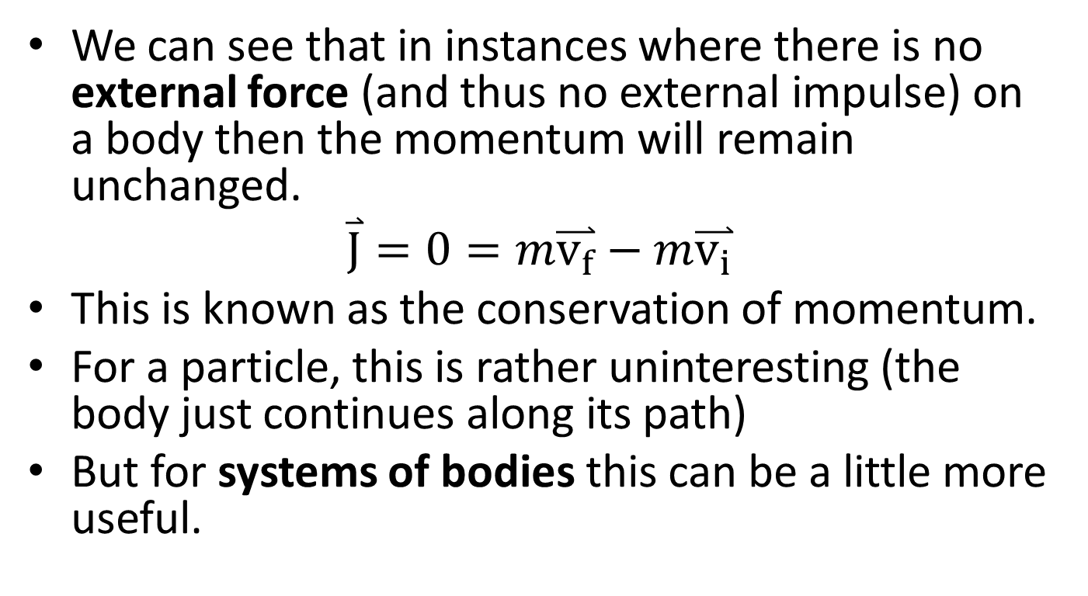
The Conservation of Momentum
We can see that in instances where there is no external force (and thus no external impulse) on a body then the momentum will remain unchanged.
$$\overset{⃑}{J}=0=m\overset{⃑}{v_{f}}−m\overset{⃑}{v_{i}}$$
This is known as the conservation of momentum.
For a particle, this is rather uninteresting (the body just continues along its path)
But for systems of bodies this can be a little more useful.

Slide 7



The Conservation of Momentum for Systems of Bodies
For an example, imagine a rocket traveling through space at a given speed.
At some point, explosive bolts separate and push apart the command module from the main engine.
If we define our system as the whole rocket, this is an internal force, that doesn’t create an impulse.
Following through with our impulse momentum relationship, the total momentum of our system will not change.
$$v_{i}$$
$$v_{fA}$$
$$v_{fB}$$
m_{A+B}
m_{A}
m_{B}
$$m_{A+B}\overset{⃑}{v_{i}}=m_{A}\overset{⃑}{v_{fA}}+m_{B}\overset{⃑}{v_{fB}}$$

Slide 8
Thanks for Watching
See other engineering mechanics videos and access the full tool at…

Slide 9

Worked Example
A tennis ball (.06 kg) is served to tennis player at a speed of 10 m/s. The player then returns the ball at a speed of 36 m/s.
What is the change in momentum for the ball?
If a high speed camera reveals the impact lasted .02 seconds, what is the average force exerted on the ball?

Slide 10
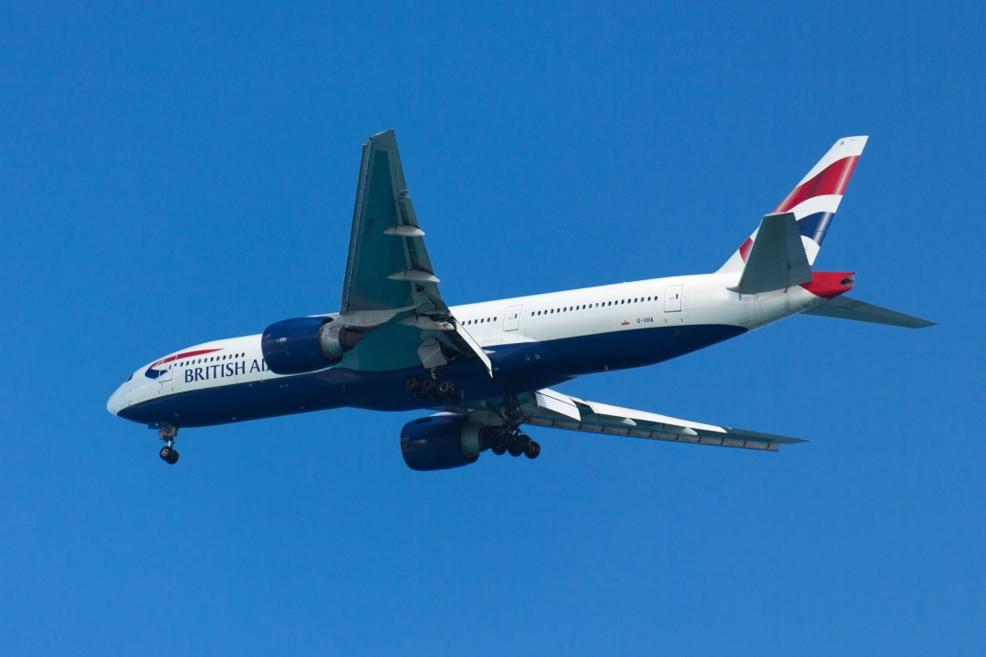
Worked Example
A plane with a mass of 80,000 kg is traveling a velocity of 200 meters per second when the engines cut out. 20 seconds later, it’s noticed that the velocity has dropped to 190 m/s. Assuming the plane is not gaining or losing altitude, what is the average drag force on the plane?

Slide 11
Worked Example
The plot below shows the thrust generated by the engine on a jet fighter (2500 kg) over ten seconds. If the plane is starting from rest on a runway and friction and drag are negligible, determine the speed of the plane at the end of these ten seconds.
12 kN
Force
(kN)
Time
(s)
4 s
10 s

Slide 12

Worked Example
A satellite with a mass of 12,000 kg and a speed of 600 m/s fires a thruster exerting a force of 600 kN at a 30º angle with the current path as shown below. The thruster is turned off after completing a 90º turn as shown below.
How long is the thruster on?
What is the final velocity of the satellite?
$$F_{T}$$
30º

Slide 13
Worked Example
A satellite with a mass of 12,000 kg and a speed of 600 m/s is traveling 30º from horizontal. If the capsule is to have the same speed but travel horizontally after 10 seconds, what is the magnitude and direction of the required average thruster force?
30º

